Slide 1

Deaconess Health System
Telemental health outpatient Obstacles

Slide 2

Began with Crisis calls being received
Resolved

Slide 3

No individual policy for Telemental Health outpatient services

Slide 4

conflicts with Walk-in appointments

Slide 5

Scheduling
MyChart-Old Method
Appts available each hour from 9am-6pm
MyChart-New Method
Appts available each hour from 9am-6pm (or 9am-7pm based upon other advertising)
Walk-in Appointments
Appts available at 9:00am, 10:30am, 12:00pm, 1:30pm, 3:00pm, and 4:30pm

Slide 6

Do we need a time limit for assessments?

Slide 7

Potential sources of scheduling conflict
Scheduling overlap with walk-ins with appointment.
  Telemental health appointment creator should coincide with walk-in appointment creator. Currently, they are not integrated.
Hourly visits do not allow for a full assessment completion before the next visit would occur.
  Allow for 1.5 hrs/assessment, unless provider staffing will increase.
Does not allow for all locations to be serviced in a timely fashion, impacting contracts, expectations, bed usage, and provider guidance in handling patients in mental health crisis

Slide 8


Lunch?
Break?

Slide 9

Not on the schedule
Walk-ins at DCP
Walk-ins at DGW
Walk-ins at DMT
Walk-ins at Gibson
Walk-ins at PCM
Walk-ins at Henderson

Slide 10

Does not indicate that currently only serving Indiana patients for mental health appointments
DHS Website Should indicate services available in each state, as not all offerings are available for all patients in the DHS service area utilizing Telemental Health Outpatient Services

Slide 11

training videos are staticky and ineffective
Not catered to the needs or practice of telemental health

Slide 12

Telehealth department did not reach out and train prior to rollout

Slide 13

Referrals are limited due to territory covered and distance from location, despite being in-state
Perhaps should indicate not just state, but service area

Slide 14

Patients expect:
Medication Mgmt
Counseling
Full Mental Health Assessment and diagnosis
Speak to a psychiatrist

Slide 15
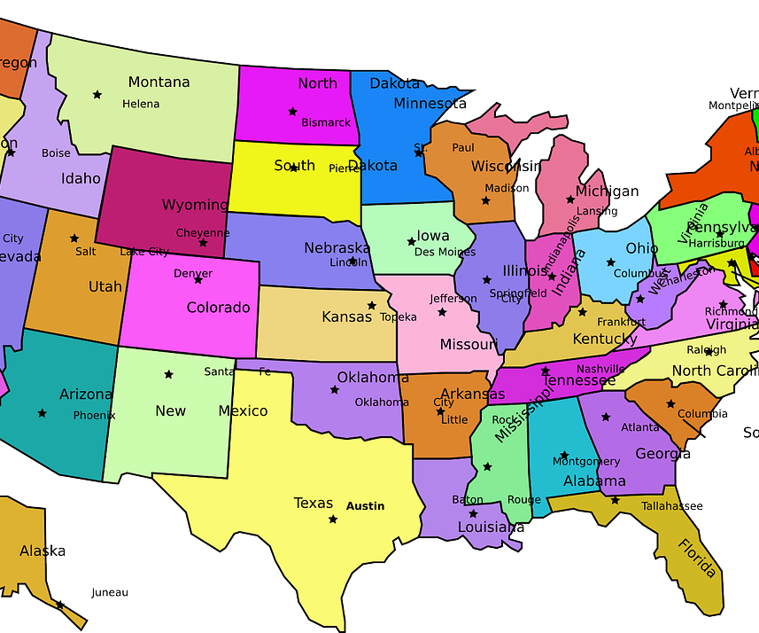
Telehealth Laws May vary by state
Need to be licensed in each state where services are provided

Slide 16
* Average Age: 36
* Females 3X more appointments vs. males
*Small percentage of one percentage point = noncisgender
*58% of appointments were unsuccessful
*41% Misunderstanding about services offered
(out-of-state, medication mgmt., therapy appointment, psychiatrist present, belief patient could be seen without gaurdian present, etc.)
*35% were out-of-state appointments
*31% were no-shows, in addition to having other conflicts
*42% of Appointments were successful
Results

