Slide 1
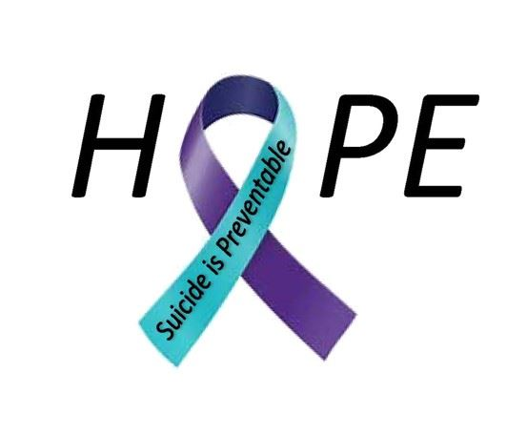
STANDUP ACT 2019
By: Angela Anderson, Cornelia Campbell, and Dewana Posely
SOCW 608- Advanced Social Policy
December 2019

Slide 2

Name Of Bill
116th CONGRESS
1st Session
H.R. 2599
The Suicide &Threat Assessment Nationally Dedicated to Universal Prevention
or the STANDUP Act of 2019
H.O.P.E.S.
Hooked on Preventing & Ending Youth Suicide

Slide 3
Purpose of Advocacy Plan
The group will be advocating for the passing of the H.R. 2599 bill.
The passing of this bill would implement policies in the school system that have been proven effective through evidence-based research in reducing the rates of;
suicide
bullying
aggression

Slide 4
The STANDUP Act seeks to
establish a suicide awareness and prevention policy in schools,
as well as prevention training policy aimed at developing in-school threat assessment teams.

Slide 5
Purpose of Bill
This proposed bill if passed:
will begin to provide a universal suicide school model for all states.
will address issues surrounding the increase in suicide among youths in school.
will serve students from grades six (6) through twelve (12).
advocates for youth but also impacts teachers, administrators, and other school staff, who will be liable to provide a safe and positive learning environment for students.

Slide 6
Problem
Suicide - can be defined as the act of taking ones own life.
Suicidal ideation- refers to thinking about suicide, or having a plan to commit suicide.
Suicides and suicidal ideations are caused by reactions to stressful life circumstances/situations, and often the only thought of solution is to end life, which would end all problems.
The thought of ending life to solve problems, has led to an increase in the rates of suicide in the U.S.
At times these individuals also end the lives of others around them, such as in the event of school shootings, then taking their own life as well.

Slide 7
Why care about suicide?
The youths are an important part of our society, and proactive steps need to be taken in providing suicide aware personnel who can recognize symptoms of suicide among the youth and provide early intervention to address the issue leading to the suicide thought.
Suicide policies implemented in schools today could be beneficial or positively impact a loved one in the future.

Slide 8

Why care about suicide?
Suicide rates have tripled among 10 to 24-year old in the United States have tripled since 1960, with 1,700 completed suicides taking place yearly. This rate will continue to rise until society takes action.
(Crouse, 2014)

Slide 9
HISTORICAL CONTEXT

Slide 10
PROBLEM CREATED
SUICIDE HAS BECOME
A BIG
PUBLIC HEALTH PROBLEM.

Slide 11
Mid 1990 – Suicide becomes a central issue in United States.
1996 – Congressional Resolutions S. Res. 84 and H. Res. 212 of the 105th Congress to recognize suicide as a national problem and suicide prevention as national priority.
https://www.ncbi.nlm.nih.gov/books/NBK109918/

Slide 12
HISTORICAL CONTEXT
The first suicide prevention center in the US opened in Los Angeles, California in 1958, with funding from the US Public Health Service.
In 1966 the Center for Studies of Suicide Prevention was established by the National Institute of Mental Health (NIMH), which was followed by the creation of nonprofit organizations dedicated to the cause.
In 1983, the Centers for Disease Control and Prevention (CDC) developed a violence prevention program that brought public attention to a disturbing increase in the youth suicide rate.

Slide 13
Historical Context TIMELINE
1958: first suicide prevention center in the United States opened in Los Angeles.
1966: Center for Studies of Suicide Prevention was established by the National Institute of Mental Health (NIMH), which was followed by the creation of nonprofit organizations dedicated to the cause.
1970: NIMH task force convene in Phoenix, Arizona and published finding in Suicide Prevention in the 70’s report.
https://www.ncbi.nlm.nih.gov/books/NBK109918/

Slide 14
Historical Context TIMELINE
1983: the Centers for Disease Control and Prevention (CDC) developed a violence prevention program that brought public attention to a disturbing increase in the youth suicide rate.
1989: Task Force on Youth Suicide established by the Secretary of the U.S. Department of Health and Human Services (HHS).
Mid-90s: Suicide becomes a central issue in the United States.
1996: Congressional Resolutions of the 105th Congress -S. Res.84 and H. Res. 2 12 , recognize suicide as a national problem and suicide prevention a national priority led by grassroots groups.
https://www.ncbi.nlm.nih.gov/books/NBK109918/

Slide 15
Historical Context Related Bill
S.2492
Suicide Training and Awareness Nationally Delivered for Universal Prevention Act of 2019
Sponsor: Sen. Gardner Cory (R)
Introduced 9/17/2019
Referred to Committee on Health, Education, Labor and Pensions
https://www.congress.gov/bill/116th-congress/senate-bill/2492/related-bills

Slide 16
Historical Context Statistics
Suicide is second leading cause of death in ages 10-24.
7.4% youth in grades 9-12 reported at least one suicide attempt in past 12 months.
70% youth who complete suicide tells someone of their plans or give warnings signs.
Suicide cost in excess of $50.8 billion.
(Mindwise Innovations, 2016)
(NIMH, 2019)

Slide 17



Slide 18


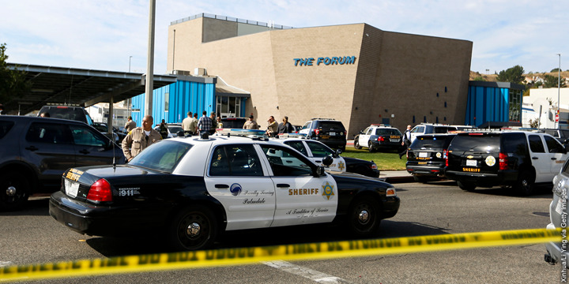

Slide 19
116th CONGRESS
1st Session
H. R. 2599
To amend the Public Health Service Act to require State educational agencies and tribal educational agencies receiving funds under section 520A of such Act to establish and implement a school-based student suicide awareness and prevention training policy and school threat assessment team policy, and for other purposes.
IN THE HOUSE OF REPRESENTATIVES
May 8, 2019
Mr. Peters (for himself, Mr. Bilirakis, Mr. Deutch, and Mr. Fitzpatrick) introduced the following bill; which was referred to the Committee on Energy and Commerce

Slide 20
Congressmen from multiple states support this federal bill. It was originally introduced by congressman Scott Peters (D-CA-52) and Gus Bilirakis (R-FL-12)
Co-sponsors include Theodore Deutch (D-FL-22), Brian Fitzpatrick (R-PA-1), Ann Fitzpatrick (D-AZ-2), Mike Quigley D-IL-5), Sean Maloney (D-NY-18), Debbie Wasserman Schultz (D-FL-23), Judy Chu (D-CA-27), Paul Tonko (D-NY-20), Jose Serrano (D-NY-15), Kathleen Rice (D-NY-4), and Drew Ferguson (R-GA-3).
Along with these representatives, the National Association of Social Workers (NASW) signed on to a Sandy Hook Promise letter to declare their support for the passing of the STANDUP Act. Sandy Hook Promise is a national non-profit social services agency founded by members who lost a relative in the Sandy Hook Elementary Mass School Shooting.

Slide 21
CURRENT CONTEXT

Slide 22
SCHOOLS ARE A KEY SETTING FOR SUICIDE PREVENTION.

Slide 23
H.R. 2599
THIS PROPOSED BILL* IS STILL PENDING AND NO DATE HAS BEEN SET TO MOVE IT FORWARD.
*ADVOCACY IS NEEDED TO GET IT ON THE CALENDAR TO BE PASSED.

Slide 24
H.R. 2599
IN THE HOUSE OF REPRESENTATIVES
May 8, 2019
Introduced and supported in House of Representatives
- Scott Peters (D-CA-52)
- Gus Bilirakis (R-FL-12)
Co-sponsors (35 total)
  -Theodore Deutch (D)
  -Brian Fitzpatrick (R)
  -Ann Fitzpatrick (D)
  -Mike Quigley (D)
  -Drew Ferguson (R)

Slide 25
H.R. 2599
COMMITTEE
05/08/2019
HOUSE – Energy and Commerce
Latest Action: Referred to the House Committee on Energy and Commerce

Slide 26
H.R. 2599
States with Suicide Prevention Legislation
As of 2018, at least ten bills have been enacted around suicide prevention in schools in the following states:
    Colorado Kentucky
    Idaho Rhode Island
    Indiana Utah
    Iowa New Mexico
In 2019, Senate introduced S.2492: Suicide Training and Awareness Nationally Delivered for Universal Prevention Act of 2019
    https://www.educationdive.com/news/at-least-8-states-this-year-have-passed-laws-related-to-youth-suicide-preve/532835/

Slide 27
LET NO YOUTH END LIFE
The value Americans place on youth and life itself is also part of the framework. This value serves as the anchor of the framework.
Saying (“Let No”) “Youth End Life” reframes the term “Youth Suicide” to point out that it is about death taking place far too soon, in a culture that highly prizes the joy of youth and the hope of a long life.
Youth itself and the end of life are at different ends of a continuum, and we should do all we can to prevent the loss of life—and certainly young life.

Slide 28
Advocacy plan: Vote “YES on H.R. 2599
Our brand “Let No Youth End Life” recognizes that solutions require collective participation from the mass public.
The framework focuses on political and environmental factors that contribute to the youth suicide problem.

Slide 29
Advocacy Plan: Focus and Target Population
FOCUS: Suicide Prevention
TARGET: Youth*
*Begin with Youth in Tennessee and then reach out to other states to ensure all states are advocating to get this bill on the calendar.

Slide 30
Elevator Pitch
It hurts us to hear that youths are ending their lives by committed suicide and I am tired of seeing nothing being done about it or trying to prevent it. I am advocating the STAND-UP 2019 which amend the bill to fund institutions surrounding suicide awareness and prevention. Did you know that suicide is the second leading cause of death among youth 10 to 24 years old in the U.S? Our children are our future. Don’t you hate that our children are choosing to take their lives. Follow our Facebook and stand with me to advocate for the STAND-UP Act 2019, to help our children live.

Slide 31
Justification
It hurts us to hear that youths are ending their lives by committing suicide. We are advocating the STAND-UP 2019 which amend the bill to fund institutions surrounding suicide awareness and prevention. Our children are our future. No Youth should feel a need to end their life. Stand with us to advocate for the STAND-UP Act 2019, to help our children live.

Slide 32
References
Stone DM, Simon TR, Fowler KA, et al. Vital Signs: Trends in State Suicide Rates --- United States, 1999-2016 and Circumstances Contributing to Suicide – 27 States, 2015. MMWR Morb Mortal Wkly Rep 2018: 67:617-624.
VA National Suicide Data Report, 2005-2016’ report, September 2018, U.S. Department of Veteran Affairs, Health Services, Suicide Prevention Program.(https://www.mentalhealth.va.gov/docs/data-sheets/OMHSP_National_Suicide_Data_Report_2005-2016_508.pdf)
U.S. CDC WISQARS Fatal Injury Data, 2017 update; National Center for Injury Prevention and Control. Accessed March 2019 (https://www.cdc.gov/injury/wisqars/index.html)
116th Congress. (n.d.). H.R. 2599 - Suicide and Threat Assessment Nationally Dedicated to Universal Prevention Act of 2019. Retrieved from https://www.congress.gov/bill/116th-congress/house-bill/2599?q=%7B%22search%22%3A%5B%22hr+2599%22%5D%7D&s=4&r=1
Bill Track 50. (n.d.). US H.R. 2599. Retrieved from https://www.billtrack50.com/billdetail/1122335
H. R. 2599 The Standup Act: Retrieved from https://www.congress.gov/bill/116th-congress/house-bill/2599/text

Slide 33
References
116th Congress. (n.d.). All Information (Except Text) for H.Amdt. 299 to H.R. 2740. Retrieved from https://www.congress.gov/amendment/116th-congress/house-amendment/299?q=%7B%22search%22%3A%5B%22hr+2740%22%5D%7D&s=a&r=88
Crouse, J.S. (2014, January 9). Sad Truths About Teen Suicide. Retrieved from https://www.americanthinker..com/articles/2014/01/sad_truths_about_teen_suicide.html
The Jason Foundation. (n.d.). Youth Suicide Statistics. Retrieved from http://prp.jasonfoundation.com/facts/youth-suicide-statistics/
Mindwise Innovations. (2016, February 29). Federal and State Youth Suicide Prevention Legislation and Our Schools. Retrieved from https://www.mentalhealthscreening.org/blog/federal-and-state-youth-suicide-prevention-legislation-and-our-schools
Smischney, T.A., Chrisler, A., & Villarruel, F.A. (2014, January). Risk Factors for Adolescent Suicide (Research Brief). Retrieved from https://reachfamilies.umn.edu/sites/default/files/rdoc/Adolescent%20Suicide.pdf

Slide 34
References
The Framework Institute. (2009). Changing the Public Conversation on Social Problems: A Beginner’s Guide go Strategic Frame Analysis. Retrieved at https://www.sfa.frameworkinstitute.org/
Preventing Youth Suicide. (n.d.). Retrieved October 3, 2019, from https://youth.gov/youth-topics/youth-suicide-prevention/preventing-youth-suicide.
Barden, M., Hockley. N., Makris. T. (2013). Sandy Hook Promise Foundation https://www.sandyhookpromise.org/our_impact

