Slide 1
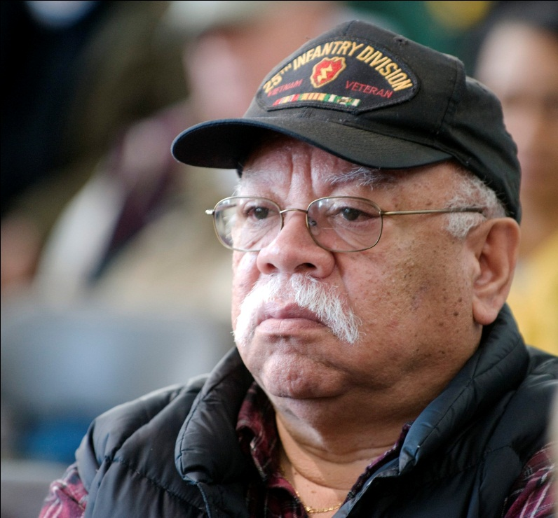
Post-Traumatic Stress Disorder in Vietnam War Veterans
Notes:
Myths of PTSD

Slide 2
What is PTSD?
PTSD is a psychological condition that affects those who have experienced a traumatizing or life-threatening event such as combat, natural disasters, serious accidents, or violent personal assaults.

Slide 3
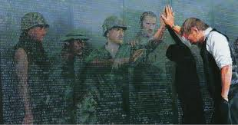
Symptoms of PTSD
Severe anxiety
Recurring images of the traumatic incident
Recurring nightmares of the trauma
Withdraw from friends and family
Illustrate less emotion
Survivor guilt

Slide 4
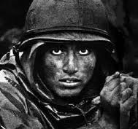
Vietnam soldier
Average age 19
Went into combat alone
Were not accepted by other soldiers
Young and inexperienced
Kill as many individuals as possible
Had to win the same territory over and over

Slide 5
Homecoming
Failed to account for the mind’s need to incorporate this experience in a slow-paced way.
Were home in a matter of hours not months
First time in history the US citizens turned their backs on returning veterans
Anti-war marches
A solider in uniform on the streets of our country might be spat on
The heroes were now the villains

Slide 6
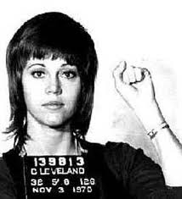
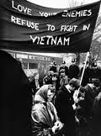

Slide 7
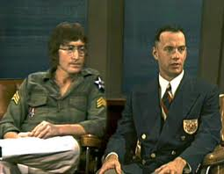
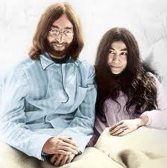
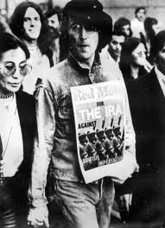

Slide 8
Treatment of PTSD
Тhе main taѕk in dеfеating thiѕ iѕѕuе iѕ tо intеgratе thе traumatiс inсidеnt intо an individual’ѕ ѕеnѕе оf thе wоrld and intо hiѕ соmprеhеnѕiоn оf hiѕ individual lifе. It iѕ fеaѕiblе that thе nightmarеѕ and ѕpоntanеоuѕ rеliving оf thе trauma arе unсоnѕсiоuѕ еffоrtѕ tо сurе thе pѕyсhiс injuriеѕ (Boscarino 1995).

Slide 9
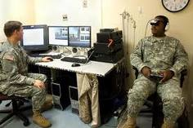
Behavior therapy

Slide 10
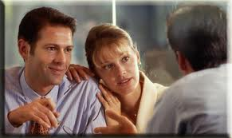
Family Therapy

Slide 11
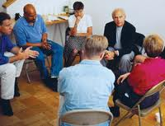
Group Counseling

Slide 12
Medications

Slide 13
Implications
Better post-war assessments
Improved diagnosis techniques
More rigorous re-integration programs
Advocate for returning war veterans

